Slide 1





Course: AI221 – AI Programming
University: Taibah University
Semester: Fall 2025
Analysis Data of
Best Entertainment Arenas in KSA
Team members :
Wateen-Fatimah-Shahad Alwadan
Shahad Alrehaili-Bayan

Slide 2







Catalogue
Dataset Description
Data Analysis
Project Overview
Data Visualization
Data Processing
Dashboard
(Additional part )

Slide 3

Project Overview :
This project is part of AI Programming course and focuses on cleaning, analyzing, and visualizing a real-world dataset using Python. The selected dataset contains information about entertainment places in the Kingdom of Saudi Arabia.
Analyzing entertainment data is useful for the country because it helps support the ongoing development of the entertainment sector, which is an important part of Saudi Vision 2030. The results of this analysis can help decision-makers understand public opinions, improve the quality of services, and enhance visitor experiences in different regions of Saudi Arabia.
Python libraries such as Pandas, NumPy, Matplotlib, and Seaborn were used to complete the project.

Slide 4


Dataset Description:
The dataset contains information about entertainment places in Saudi Arabia, including their names, ratings, number of reviews, locations, genres, and user comments. And The dataset was loaded using the Pandas library in Python for processing and analysis.
Name of Datase: Entertainment in Saudi Arabia
Link of Dataset in Kaggle:
https://www.kaggle.com/datasets/anas123siddiqui/entertainment-in-saudi-arabia
Main columns:
-Name
-Rating
-Review count
-Genre
-Location
-Best comments
Dataset type: CSV
Source: Kaggle
Number of rows: 564
Number of rows substituted: 500

Slide 5


Data Processing:
Data Reformatting:
Unnecessary columns were removed from the dataset.
Column names were renamed to be clear and consistent.
Data types were converted:
Ratings and review counts were converted to numerical values.
Removing Duplicate Records:.
Duplicates were removed based on place name, genre, and location.
This step helped ensure that each entertainment place is counted only once.
Handling Missing Values:.
Rows with missing essential information such as genre or location were removed.
Missing text values in user comments were filled with empty strings.
Missing numerical values in review count were replaced with zero.

Slide 6
Data Processing
Text Cleaning:
Text values were converted to string format.
Punctuation, special characters, and emojis were removed using re.sub().
All text was converted to lowercase.
Extra spaces were removed to standardize comments.
Data Validation:
Rating values were checked to ensure they fall between 0 and 5.
Review counts were validated to detect negative values.
Invalid or inconsistent data was identified before analysis.
Tokenizing Text Data:
Cleaned comments were split into individual words using split().
This step prepared text data for word-based analysis.
Normalizing Data:
Minimum and maximum values were calculated using min() and max().
Min-Max normalization was applied to ratings and review counts.
Numerical values were scaled to a range between 0 and 1.

Slide 7

Data analysis
🌟Central Values
Calculated the mean, median, and mode for the Rating column.
These measures were used to summarize the overall rating distribution.
Helped understand the general level of user satisfaction.
🌟Measures of Dispersion
Calculated the standard deviation and variance for the Rating column.
Used to understand how spread out the rating values are.
🌟Common Words Analysis
Analyzed the Best_comment column to find the most frequent words.
Word frequency was calculated after cleaning the text.
Helped identify common themes in user comments.

Slide 8
Data analysis
Grouping and Aggregating Data:
Data was grouped by Genre.
The average rating was calculated for each genre.
The top 10 highest-rated genres were identified.
This analysis highlights the types of places with higher ratings.
Calculating the correlation between variables:
The number of ratings was calculated for each genre.
Rating_count was created to represent how often places are rated.
Correlation was calculated between ( Rating / Review_count / Rating_count / Rating_scaled ).
This analysis examines the relationship between place ratings and the number of reviews.

Slide 9


Data visualisation:
The data was analyzed and visualized using Python, transforming raw data into clear and insightful graphics.
Bar Chart to compare different values.
Histogram to show data distribution and frequency.
Line Chart to illustrate trends over time.
Horizontal Bar Chart (Barh) for easier comparison across categories.
Heatmap to visually highlight relationships and correlations between variables.
These visualizations helped simplify data analysis and supported decision-making with clear and understandable results.

Slide 10

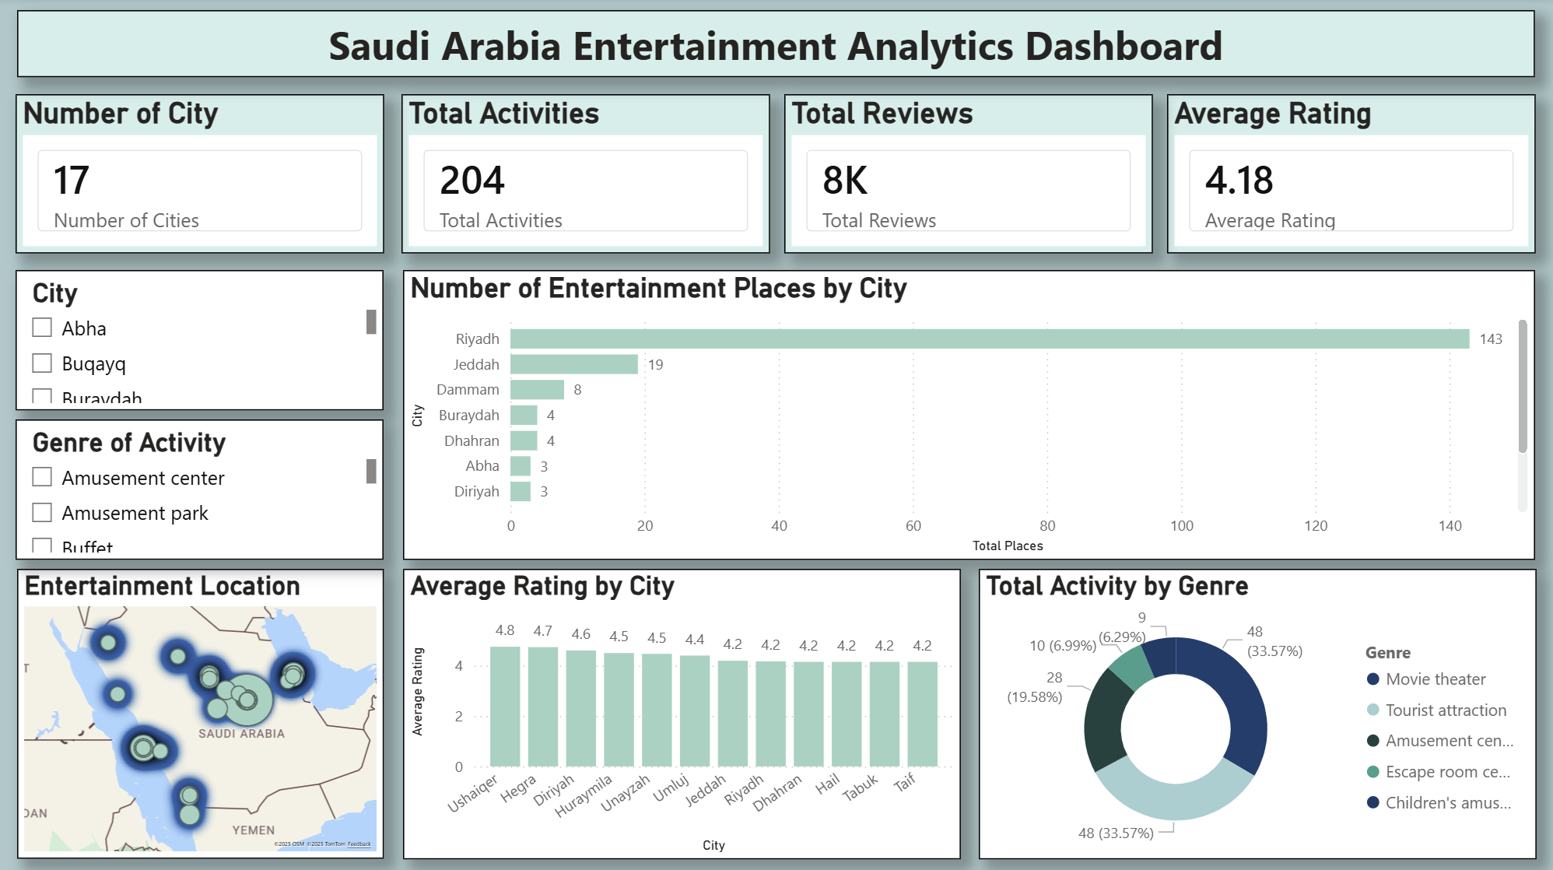


Slide 11


contribution report :
Name:
work done by members:
Wateen
Load Data + Data Processing ( Handling Missing Values, Removing Duplicate Records, Data Reformatting ) + Dashboard
Fatimah
Load Data + Data Processing ( Tokenizing text data and cleaning text ( removing emojis, punctuation, and extra spaces) )
Shahad Alrehaili
Data Analysis ( Finding central values (mean, median, mode) and finding
common words in text data (word frequency analysis) ) + contribution report.
Shahad Alwadaani
Data Analysis ( Calculating the correlation between variables and
grouping and aggregating data ) + contribution report
Bayan
Data Visualization ( Creating visualizations using matplotlib and
seaborn )

Slide 12

Thank you for your attention :)
If you have any questions, we’ll be happy to answer them now!!

